Slide 1


Contribution to Multimodal Classification Problem With Data Scarcity: Application to the Early Diagnosis of Lyme Disease
Sk Imran HOSSAIN
Université Clermont Auvergne, Clermont Auvergne INP, CNRS, ENSMSE, LIMOS, F-63000 Clermont-Ferrand, France
Thesis defense to obtain the title of Doctor of Philosophy in Computer Science
Jocelyn DE GOËR DE HERVE | INRAE | Co-supervisor
Engelbert MEPHU NGUIFO | Université Clermont Auvergne | Thesis director
FUNDING | - | Région : Project DAPPEM–AV0021029 + ERDF

Slide 2
Contents
Context
Background
Contributions
Conclusion
Context
Background
Contributions
Conclusion

Slide 3
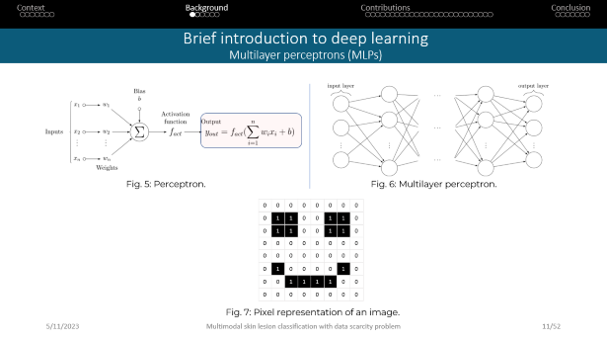
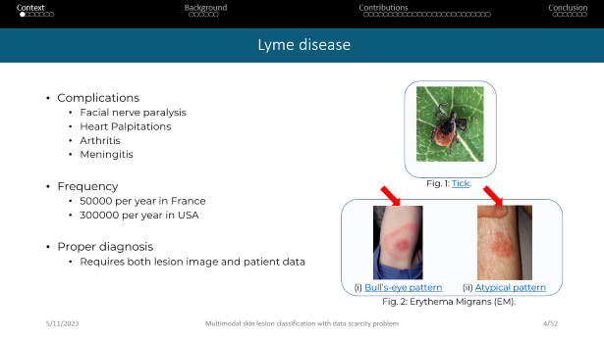
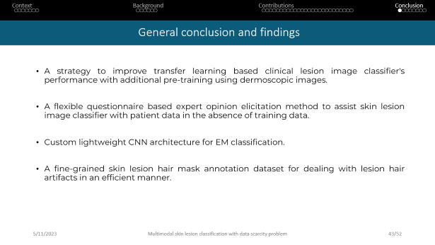
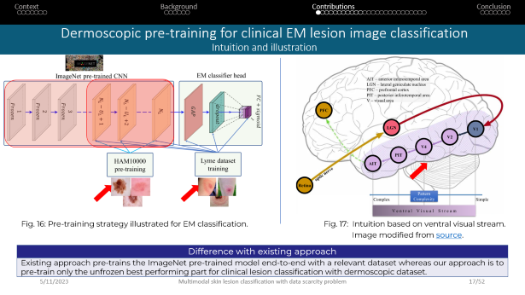
Visual outline
Context
Background
Contributions
Conclusion

Slide 4
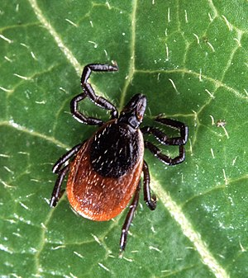
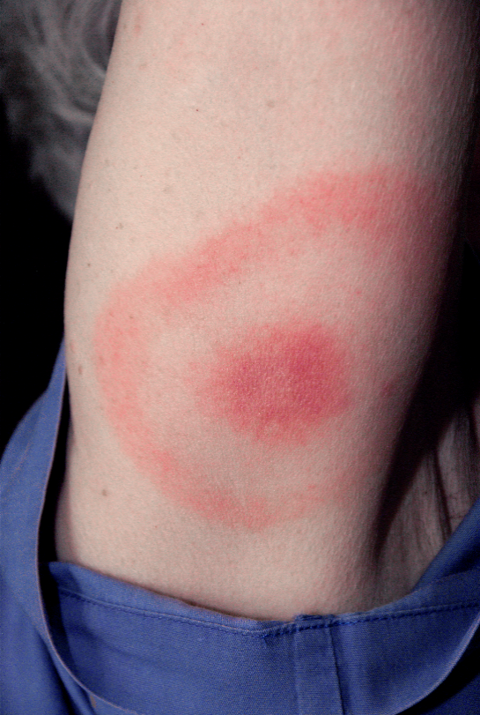
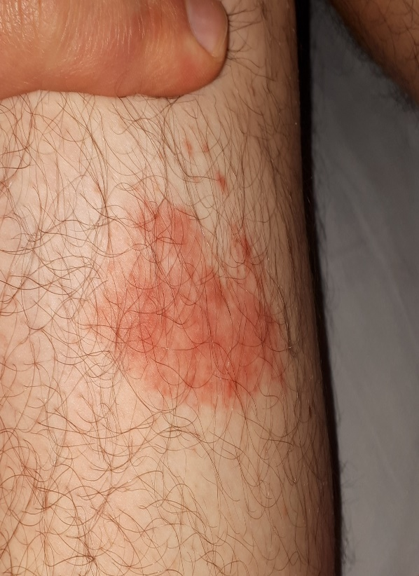
Lyme disease
Context
Background
Contributions
Conclusion
Complications
Facial nerve paralysis
Heart Palpitations
Arthritis
Meningitis
Frequency
50000 per year in France
300000 per year in USA
Proper diagnosis
Requires both lesion image and patient data
Fig. 1: Tick.
(i) Bull’s-eye pattern
(ii) Atypical pattern
Fig. 2: Erythema Migrans (EM).

Slide 5
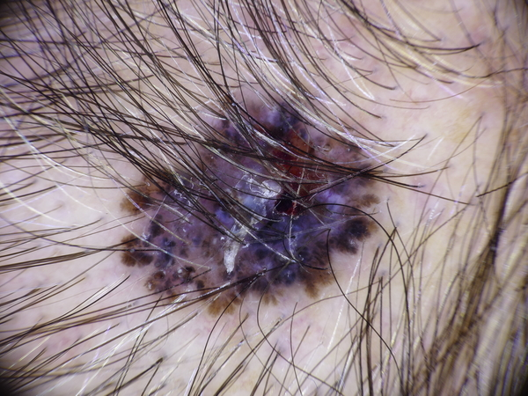
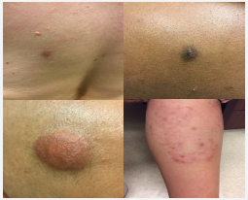
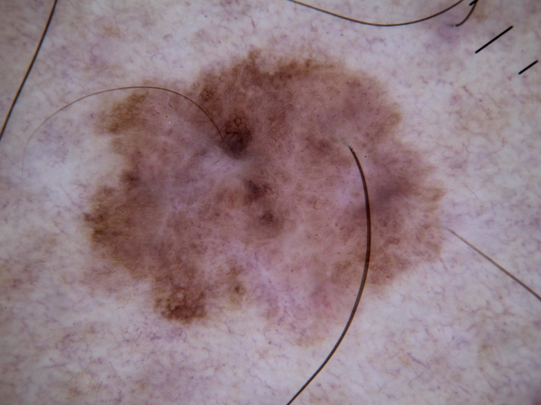
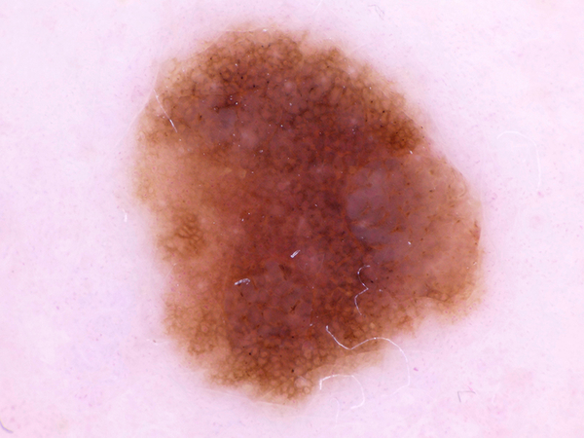
AI for diagnosing skin lesion
Context
Background
Contributions
Conclusion
Deep learning competes on par with dermatologists
Deep learning outperformed 136 of 157 dermatologists in a head-to-head dermoscopic melanoma image classification task [1].
Systematic outperformance of 112 dermatologists in multiclass skin cancer image classification by convolutional neural networks [2].
(i) Dermoscopic skin cancer lesions from HAM10000 dataset [3].
(ii) Clinical dermatology images from Google Health[3].
Fig. 3: Dermoscopic and clinical skin lesion images.

Slide 6




Multimodal diagnosis of skin lesion
Context
Background
Contributions
Conclusion
Incorporating data from multiple modalities in the analysis process significantly improves the AI models' performance compared to a single modality based analysis [4,5].
AI
AI
Clinical
patient data
Lesion image
Lesion image
Fig. 4: Multimodal vs unimodal lesion diagnosis.

Slide 7
Related works on AI assisted EM detection
Context
Background
Contributions
Conclusion
E. Čuk, M. Gams, M. Možek, F. Strle, V. Maraspin Čarman, J.F. Tasič, Supervised visual system for recognition of erythema migrans, an early skin manifestation of lyme borreliosis, Stroj. Vestnik/Journal Mech. Eng. 60 (2014) 115–123. https://doi.org/10.5545/sv-jme.2013.1046
P.M. Burlina, N.J. Joshi, P.A. Mathew, W. Paul, A.W. Rebman, J.N. Aucott, AI-based detection of erythema migrans and disambiguation against other skin lesions, Comput. Biol. Med. 125 (2020) 103977. https://doi.org/10.1016/j.compbiomed.2020.103977
Classical machine learning techniques, (Private Dataset)
Convolutional Neural Network (CNN), (Private Dataset)

Slide 8
Related works on AI assisted EM detection
Context
Background
Contributions
Conclusion
D. Jacob, O. Nankar, S. Gite, S. Patil, K. Kotecha, Lyme Disease Detection Using Progressive Resizing and Self-Supervised Learning, SSRN Electron. J. (2022). https://doi.org/10.2139/ssrn.4059738
T. Koduru, E. Zhang, Using Deep Learning in Lyme Disease Diagnosis, J. Student Res. 10 (2021). https://doi.org/10.47611/jsrhs.v10i4.2389
poster in international conference on Intelligent Systems for Molecular Biology, ISMB 2022, https://www.youtube.com/watch?v=Ge85IS853Bs
(151 EM images, unverified dataset)
CNN, (Private Dataset)

Slide 9
Related works on AI assisted EM detection
Context
Background
Contributions
Conclusion
I. Oholtsov, Y. Gordienko, S. Stirenko, Effect of Small Dataset Quality on Deep Neural Network Performance for Lyme Disease Classification, in: 2023: pp. 561–573. https://doi.org/10.1007/978-981-19-3590-9_44
(106 EM images, unverified dataset)
Limitations: considers image data only

Slide 10
Challenges of AI assisted EM detection
Context
Background
Contributions
Conclusion
Lack of well-annotated publicly available big image dataset.
Proper diagnosis of EM requires both lesion image and patient data [9].
No available training data for patient data modality.

Slide 11
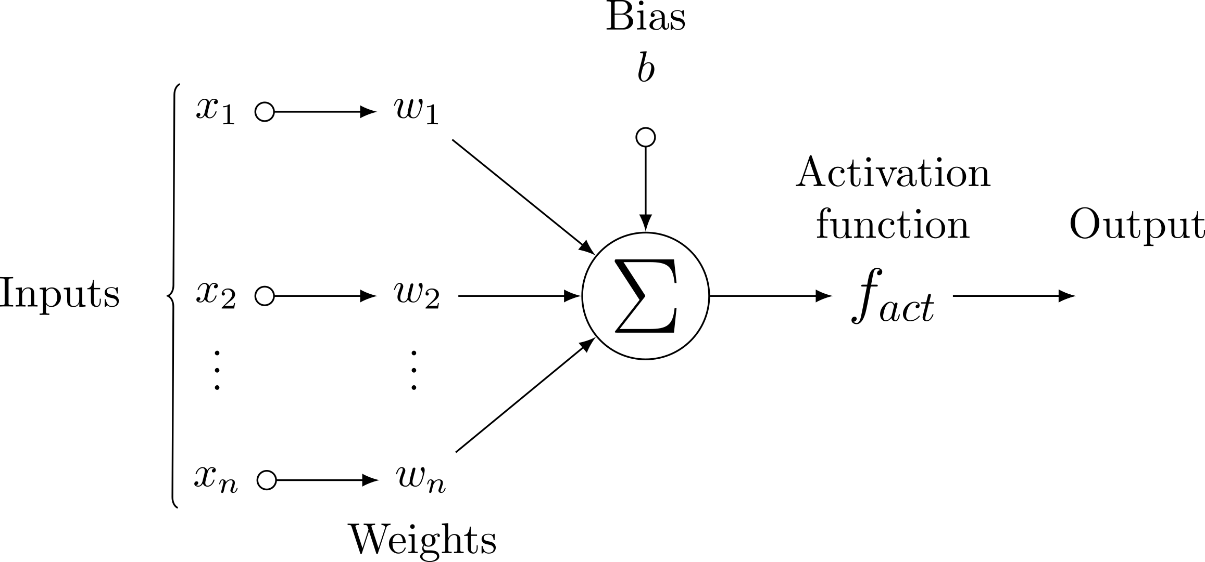
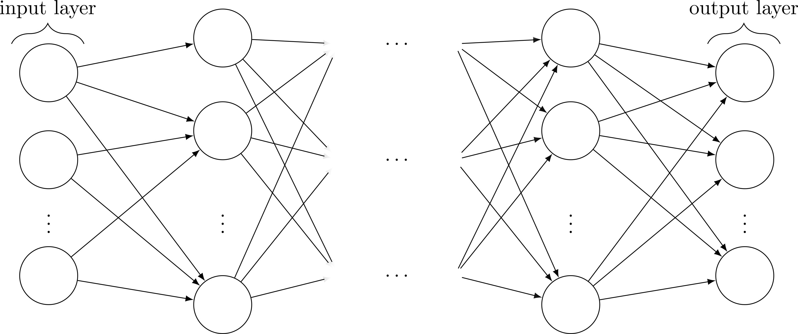
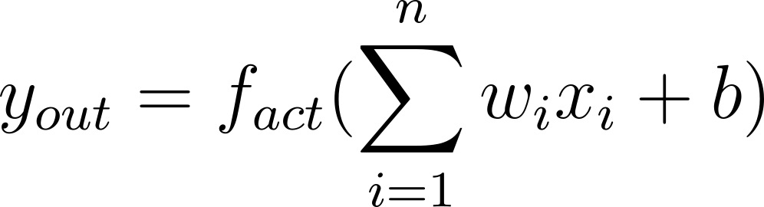
Brief introduction to deep learning Multilayer perceptrons (MLPs)
Context
Background
Contributions
Conclusion
Fig. 5: Perceptron.
Fig. 6: Multilayer perceptron.
0
0
0
0
0
0
0
0
0
1
1
0
0
1
1
0
0
1
1
0
0
1
1
0
0
0
0
0
0
0
0
0
0
0
0
0
0
0
0
0
0
1
0
0
0
0
1
0
0
0
1
1
1
1
0
0
0
0
0
0
0
0
0
0
Fig. 7: Pixel representation of an image.

Slide 12

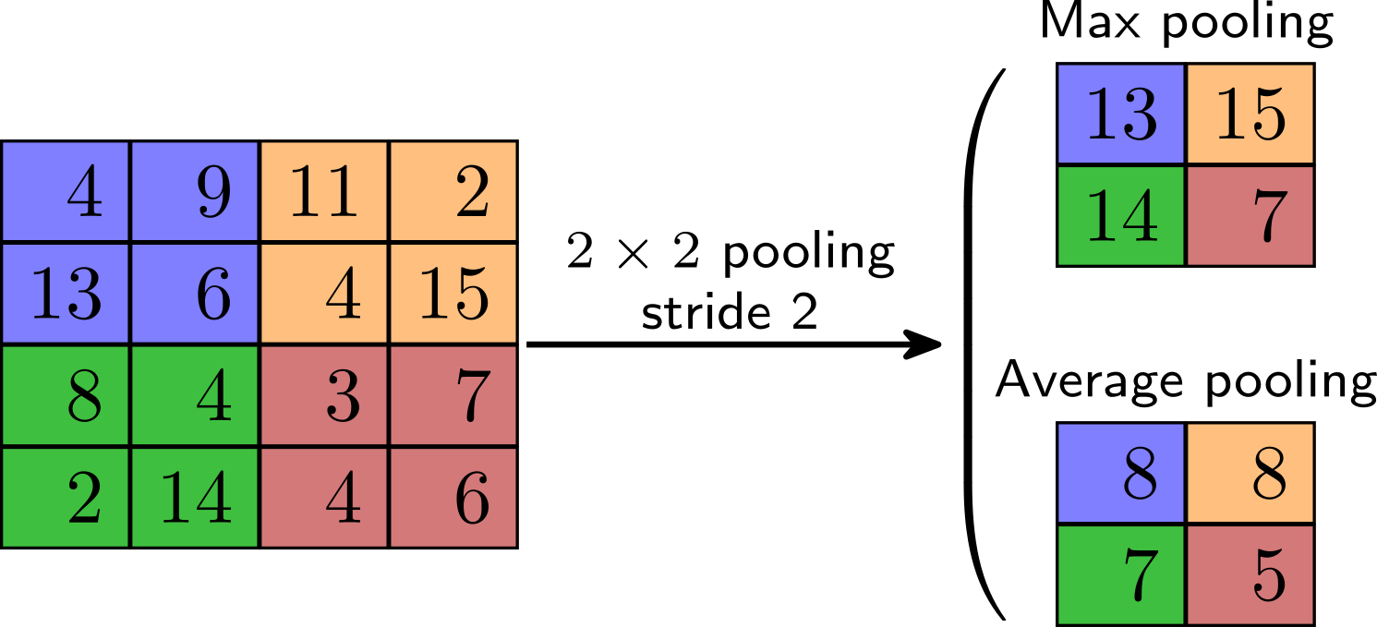
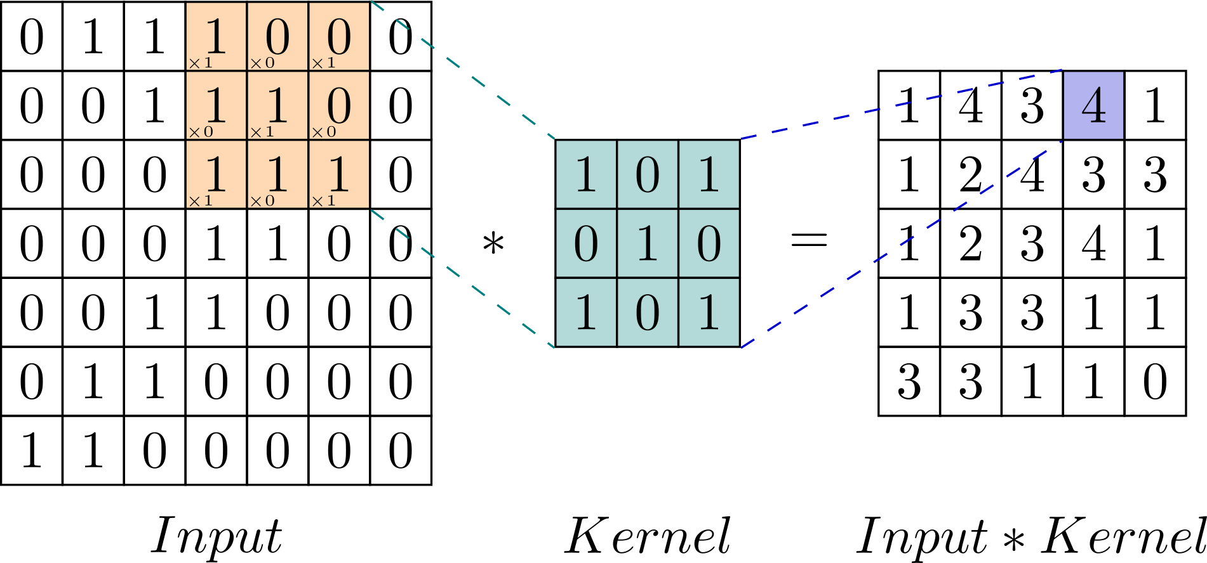
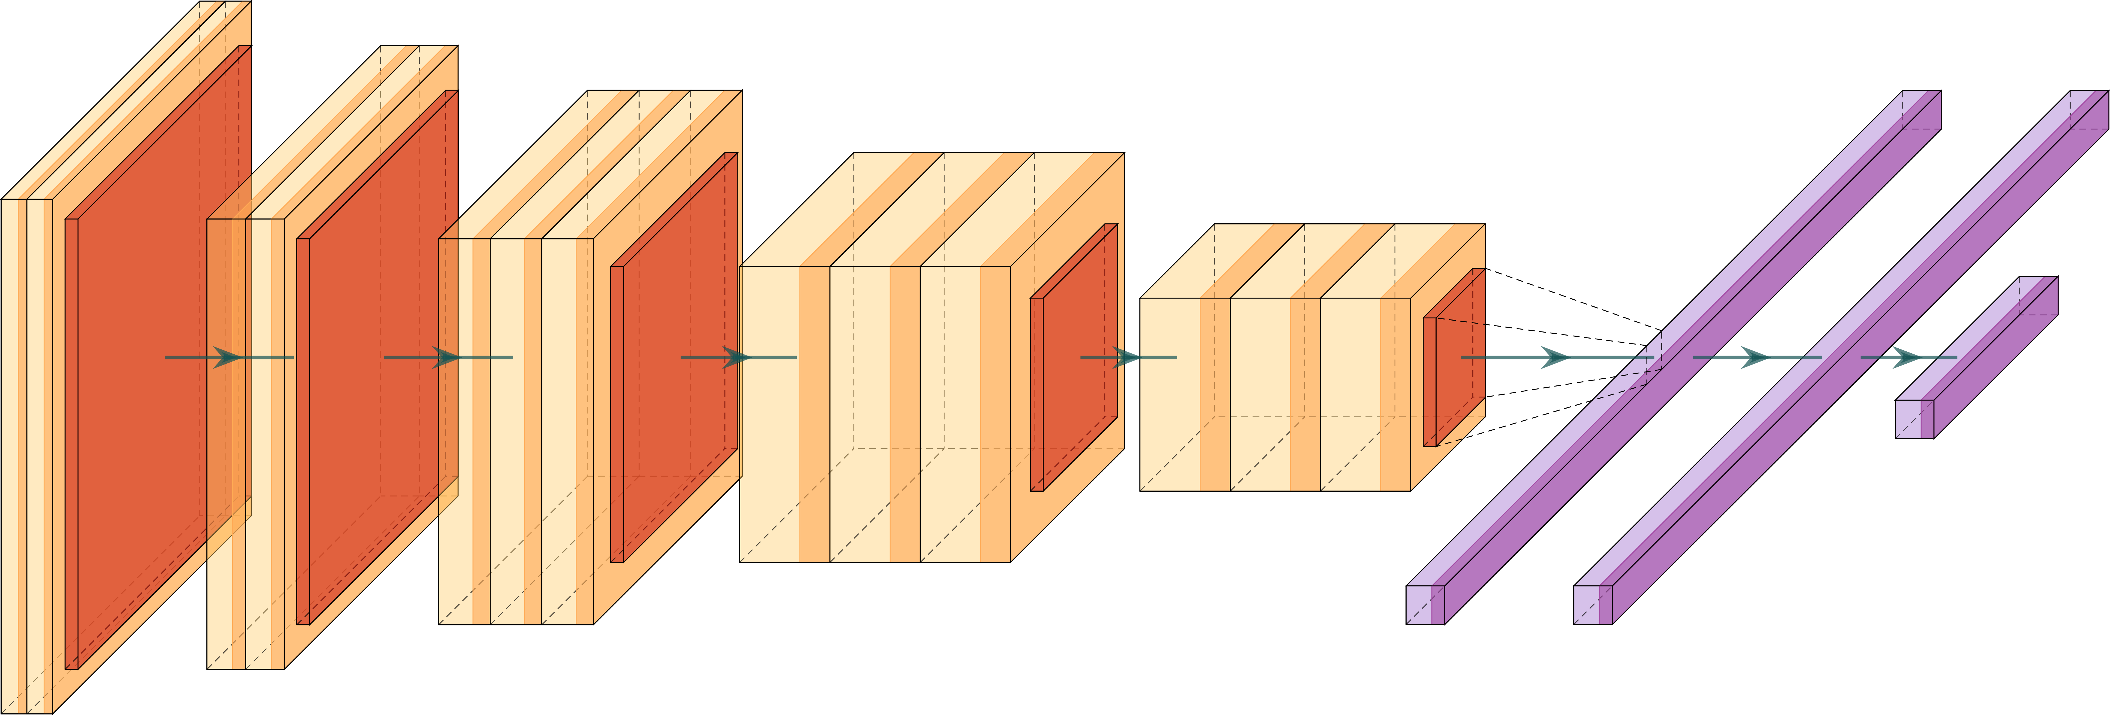
Brief introduction to deep learning Convolutional neural network (CNN)
Context
Background
Contributions
Conclusion
Fig. 8: Convolution operation. (animation source)
Fig. 9: Pooling operation.
Fig. 10: Schemtic representation of a convolutional neural network. The yellow, and violet boxes with shaded endings represent convolutional and fully connected layers respectively with activation function. Thered box represents pooling layer.

Slide 13

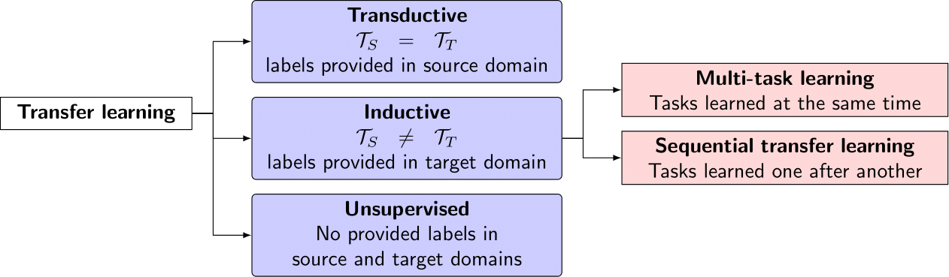
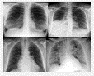
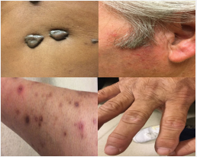
Transfer learning for dealing with image data scarcity
Context
Background
Contributions
Conclusion
ImageNet Big collection of natural images
Step1 : pre-training on ImageNet
Unlabeled dermatology images
Unlabeled chest x-rays
Step2 : End-to-end pre-training with domain-specific images
Fig. 11: Transfer learning scenarios [6].
Labeled dermatology images
Labeled chest x-rays
Step3 : fine-tuning with labeled images
Fig. 12: Sequential transfer learning for medical images [7].

Slide 14
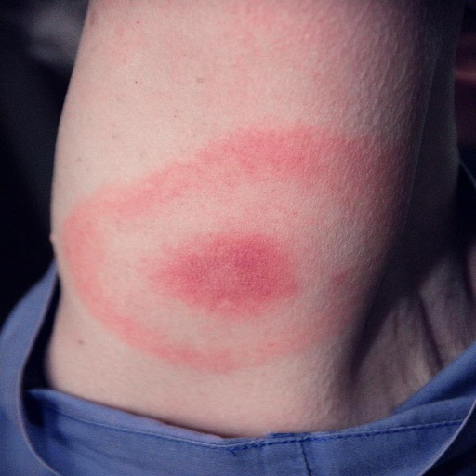
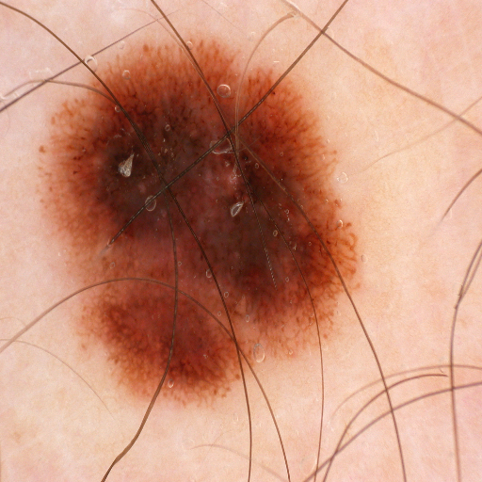
Research problem Research question 1
Context
Background
Contributions
Conclusion
Observations:
Dermoscopic image datasets are easily accessible.
Image modality of dermoscopic images are different from clinical images.
(i) Clinical EM image
(ii) Dermoscopic lesion image
Fig. 13: Clinical vs dermoscopic image.
Q1
Can we improve the performance of ImageNet pretrained clinical lesion image classifier's performance with additional pre-training using dermoscopic images?

Slide 15
Research problem Research question 2
Context
Background
Contributions
Conclusion
Observations:
Proper diagnosis of EM requires both lesion image and patient data [9].
No available training data for patient data modality.
Q2
How to assist deep learning based skin lesion image classifier with patient data in the absence of training data?

Slide 16
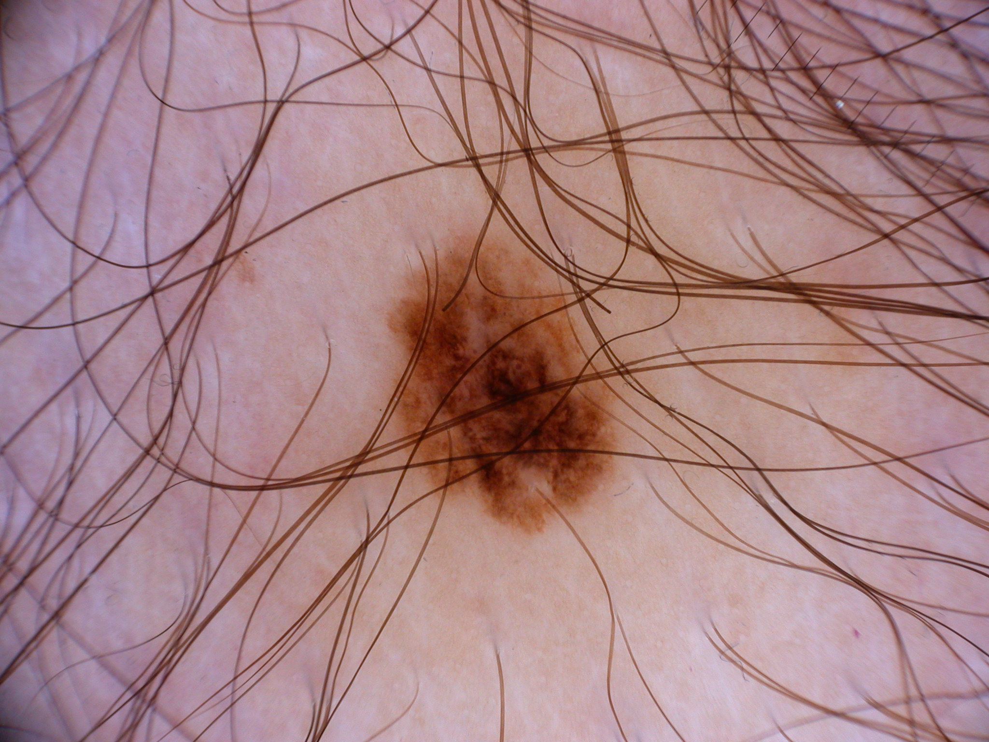
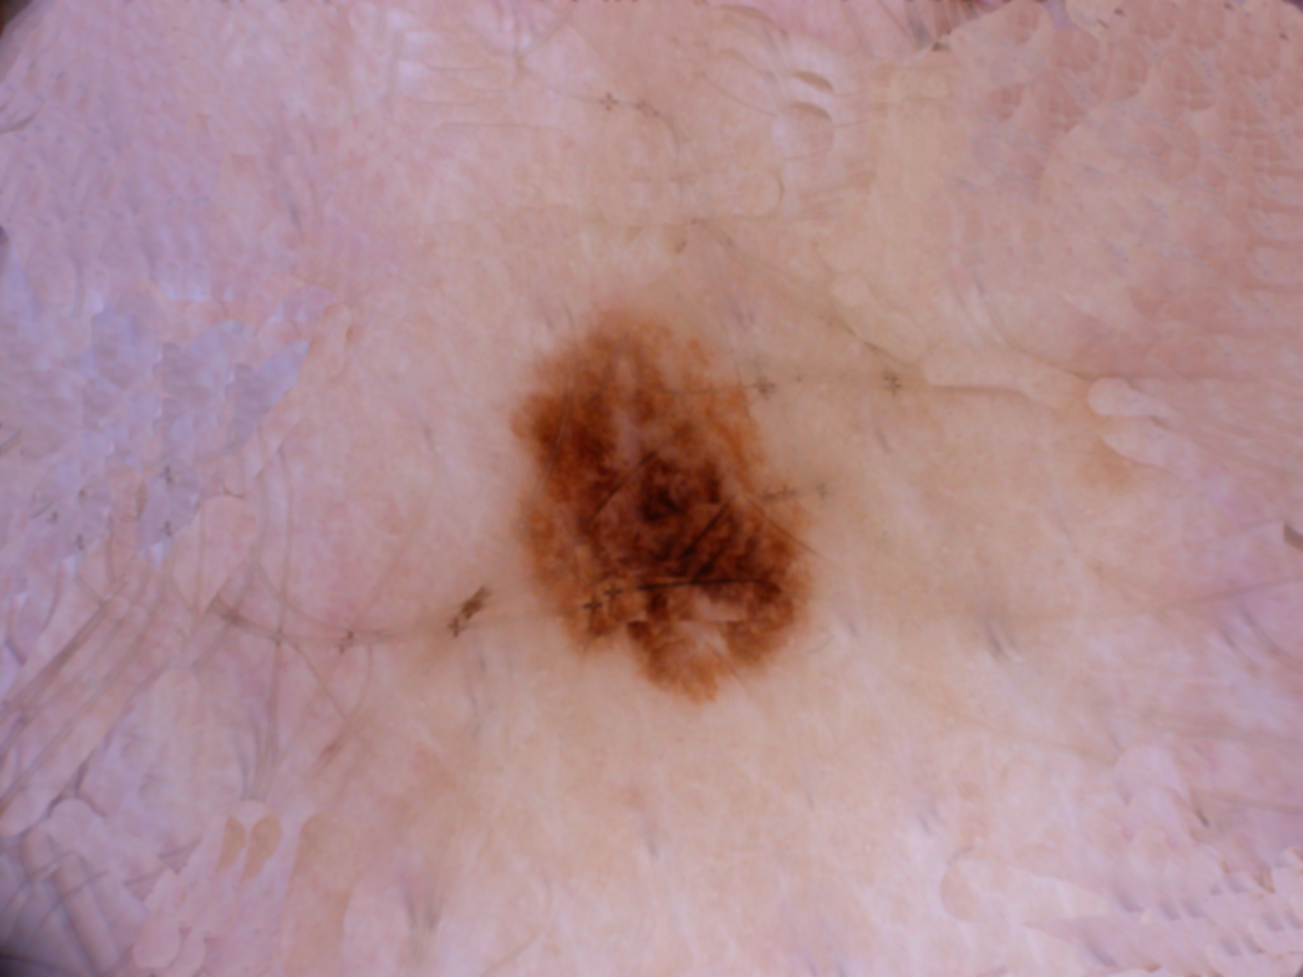
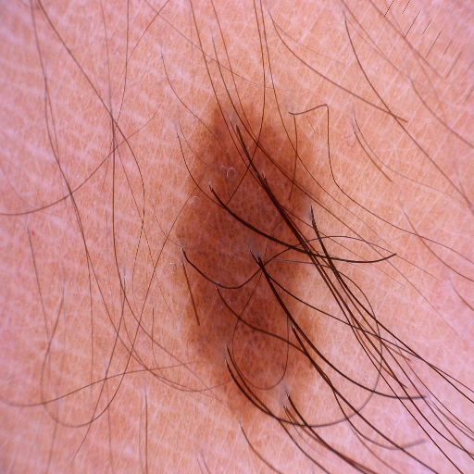
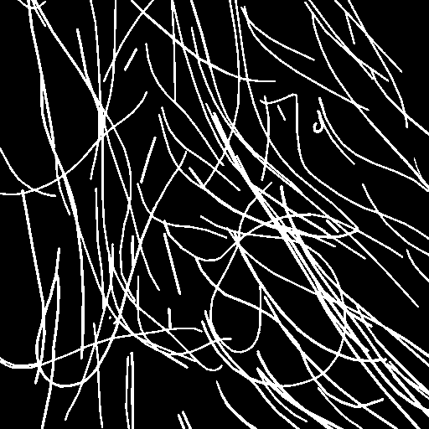
Research problem Research question 3
Context
Background
Contributions
Conclusion
Fig. 14: Skin hair removal [10].
Fig. 15: Skin hair mask.
Q3
Can training time hair augmentation replace hair removal step?

Slide 17
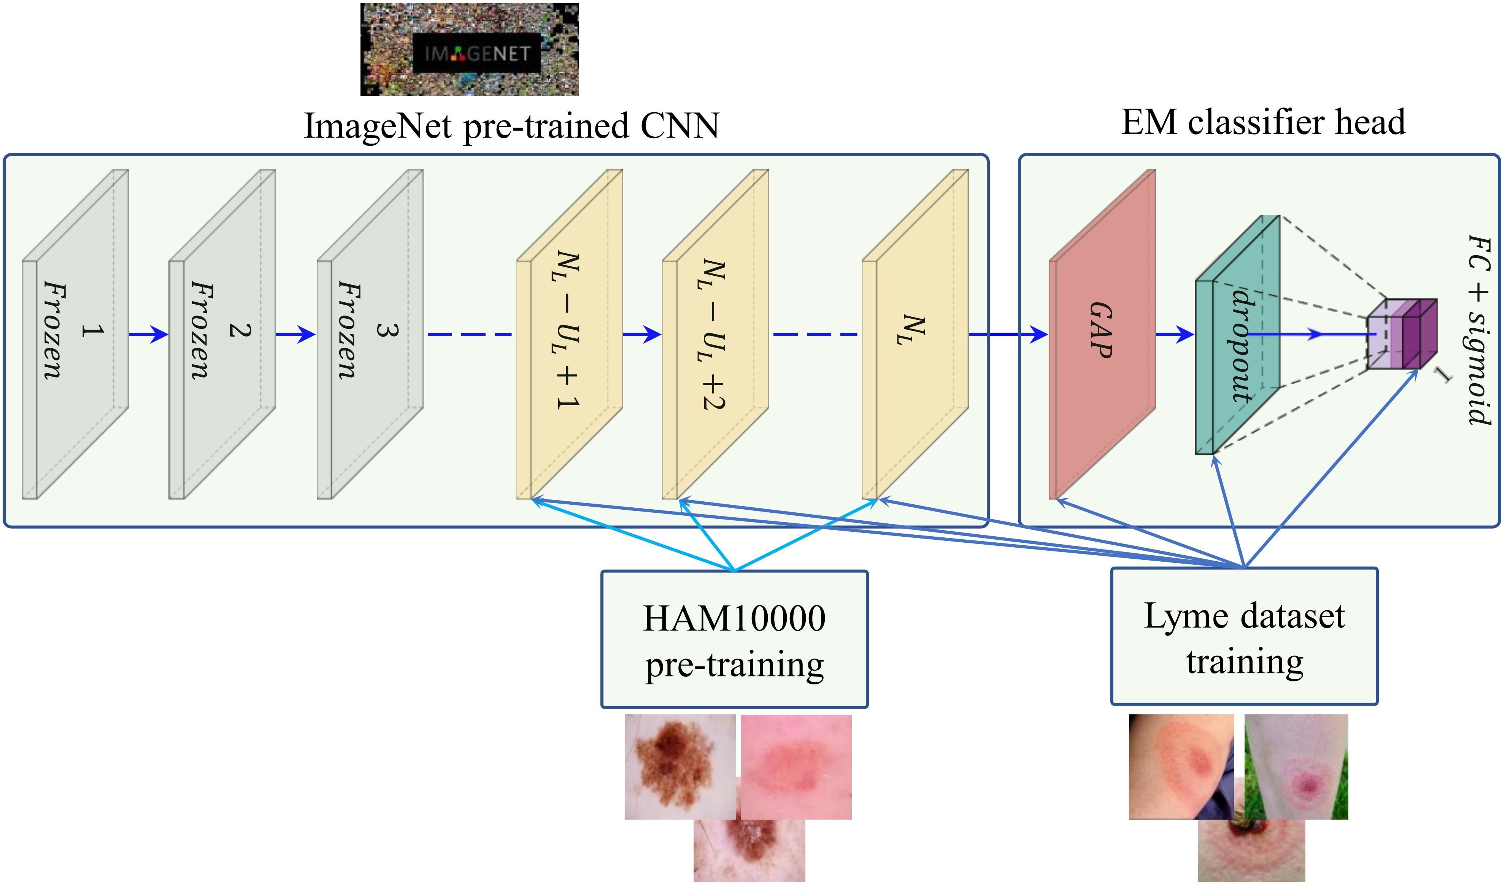
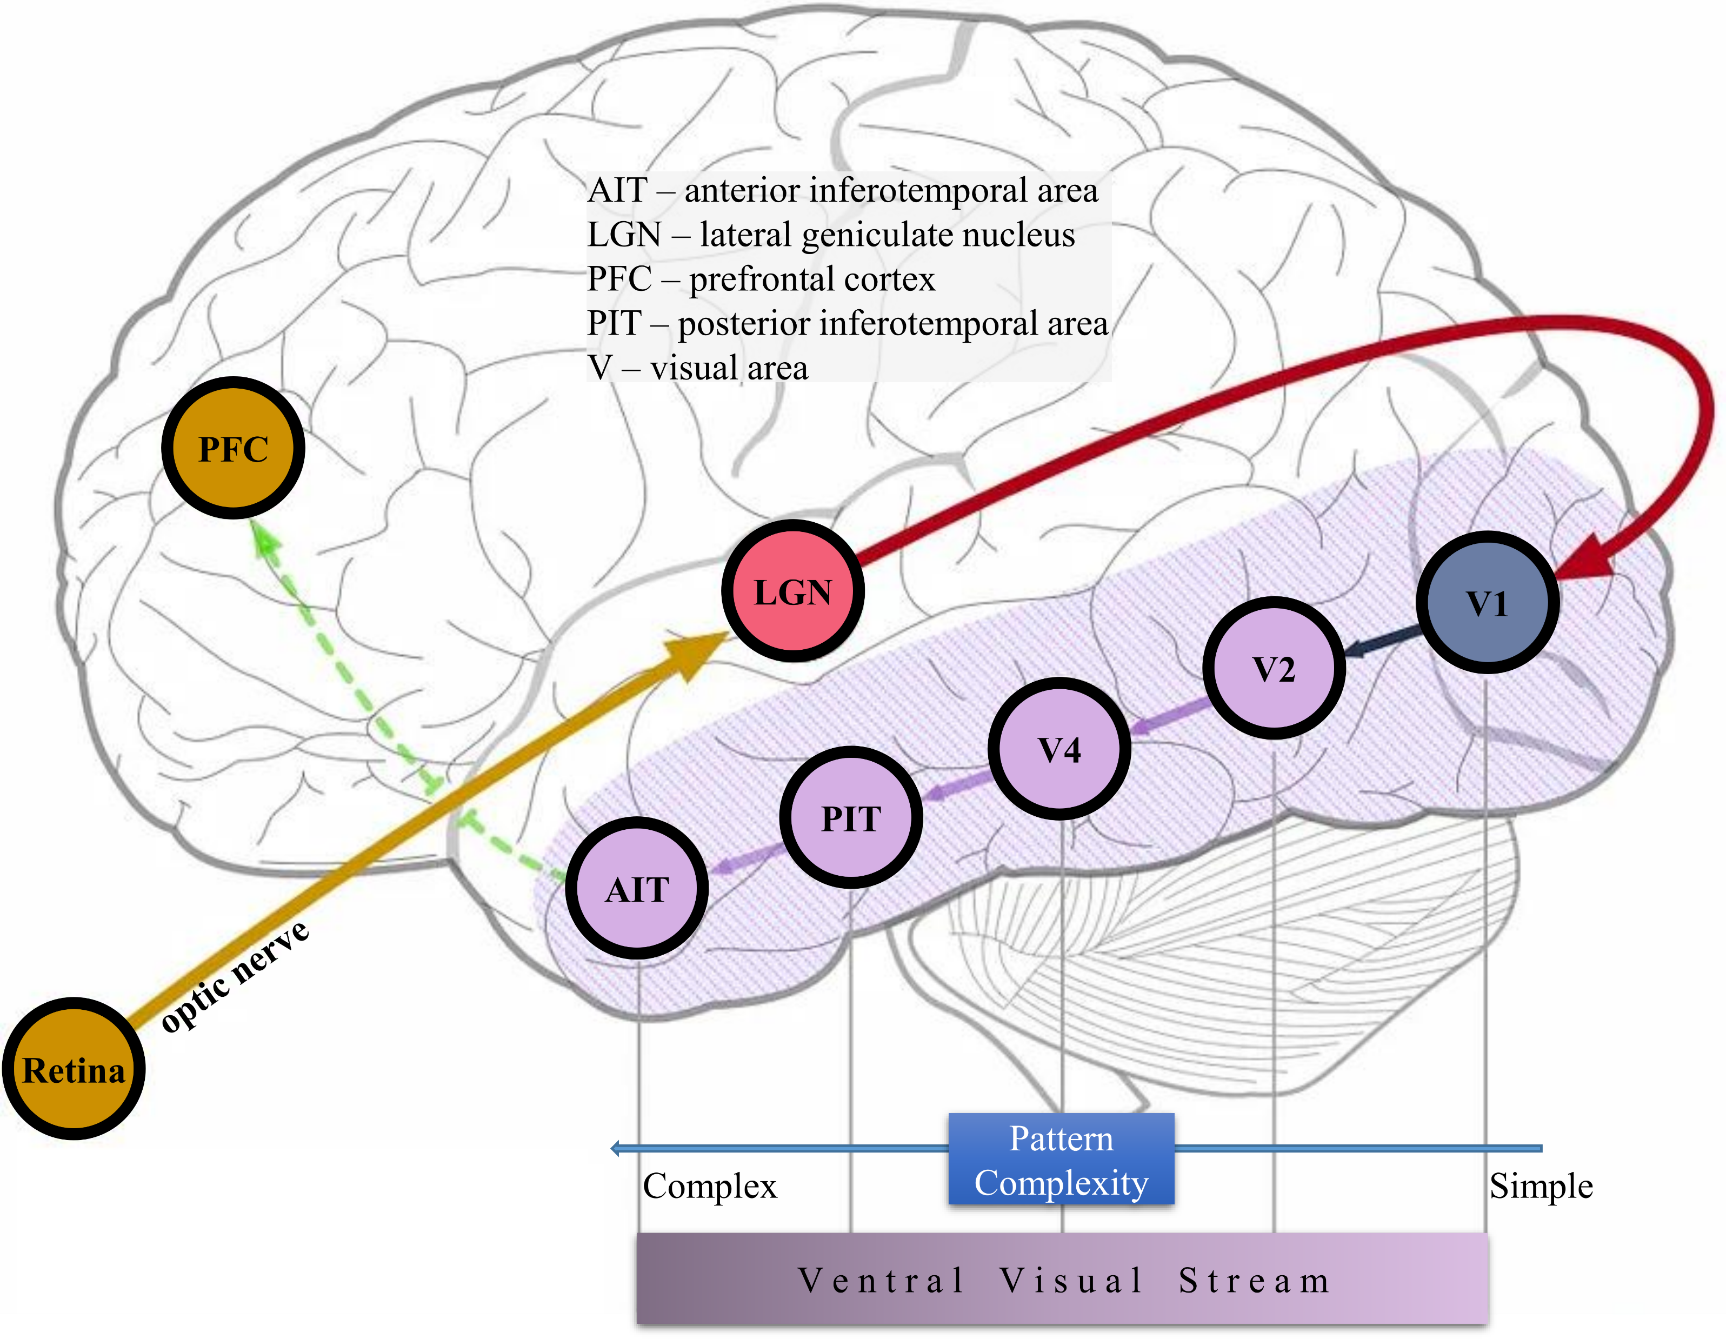
Dermoscopic pre-training for clinical EM lesion image classification Intuition and illustration
Context
Background
Contributions
Conclusion
Fig. 16: Pre-training strategy illustrated for EM classification.
Fig. 17: Intuition based on ventral visual stream.
Image modified from source.
Difference with existing approach
Existing approach pre-trains the ImageNet pre-trained model end-to-end with a relevant dataset whereas our approach is to pre-train only the unfrozen best performing part for clinical lesion classification with dermoscopic dataset.
Notes:
I started with a CNN model pre-trained on ImageNet. Then I selected some layers from the end of the model that gives best performance when fine-tuned for EM classification task while keeping rest of the architecture frozen. I then pre-trained only those layers with dermoscopic lesion images (HAM10000) followed by training with Lyme dataset.
The intuition comes from human visual system. The initial areas of our VS reacts to simple patterns and the later areas reacts to complex patterns, CNN also shows the same behavior. The initial layers of CNN reacts to basic patterns like lines and edges and the end layers learns complex pattern like object of interest.
So, the end layers trained for Dermoscopic images will react to skin lesion patterns which should serve as a good weight initialization for clinical EM classification task. It has the added benefit of updating fewer parameters compared to the end-to-end pretrainig of existing approaches.

Slide 18
Dermoscopic pre-training for clinical EM lesion image classification Proposed algorithm
Context
Background
Contributions
Conclusion

Slide 19
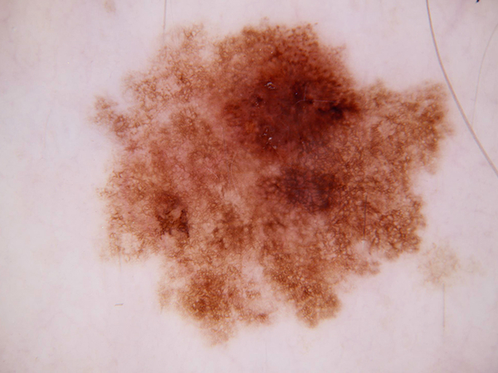

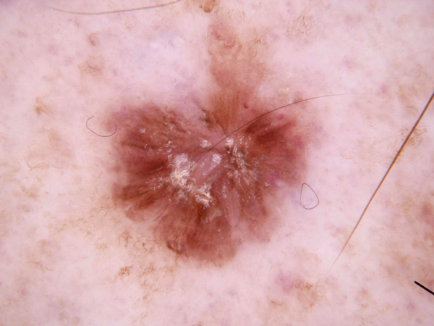
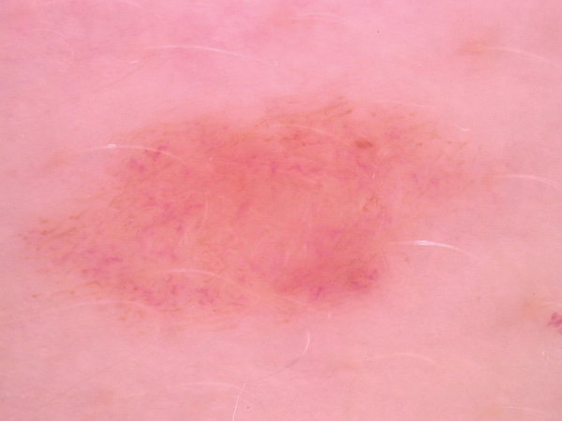
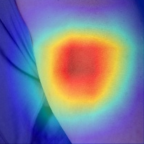
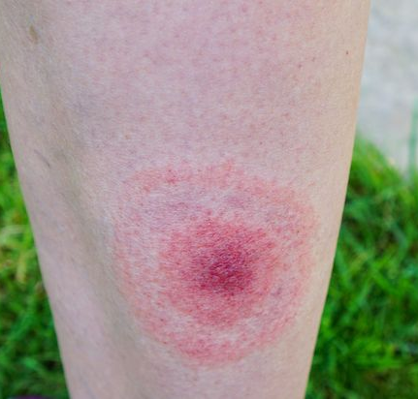
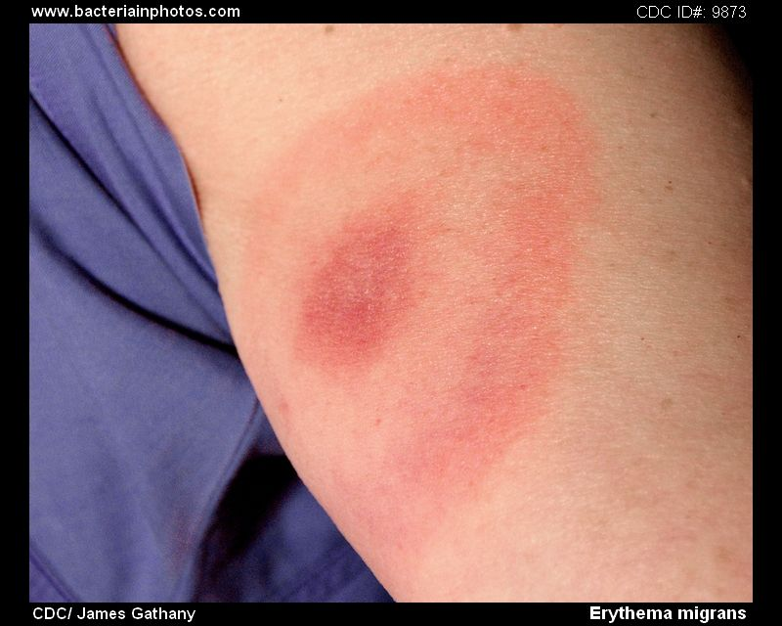
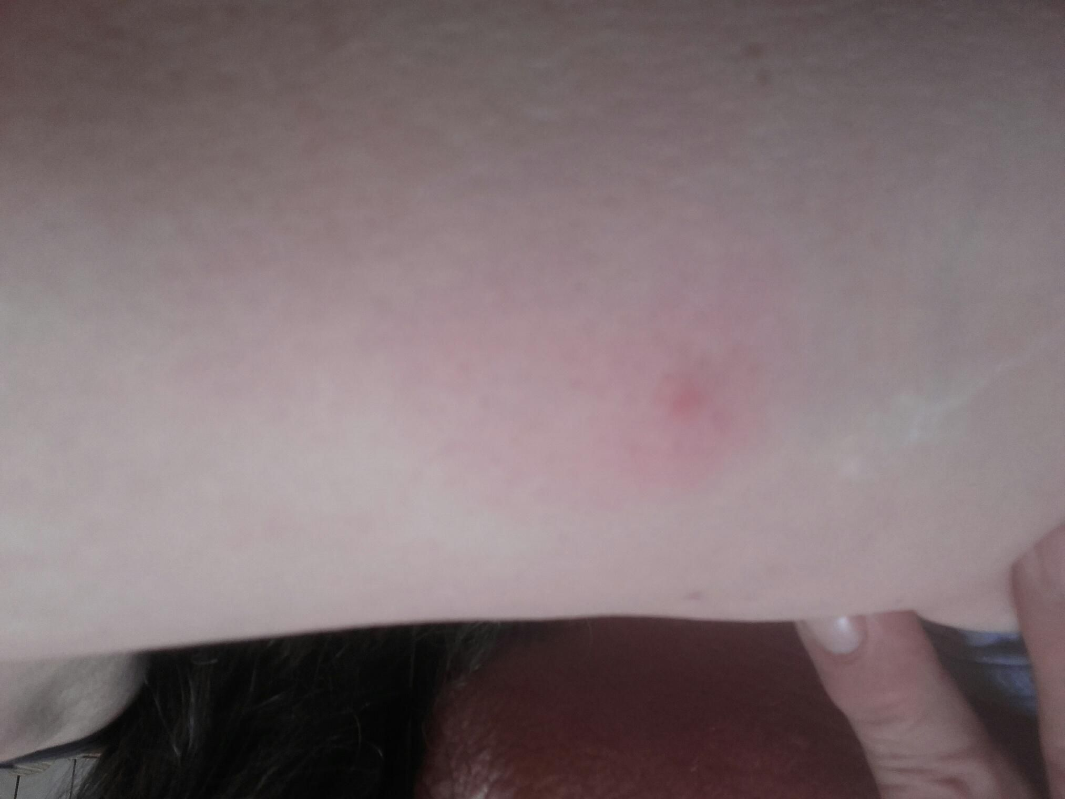
Dermoscopic pre-training for clinical EM lesion image classification Experimental study (Graphical overview)
Context
Background
Contributions
Conclusion
Predictive Performance
Which is the best CNN architecture
to diagnosis Lyme disease from images?
Model Complexity
HAM10000
Experimental Analysis
Statistical Significance
Novel Lyme Dataset
Novel Lyme Dataset
Custom Pre-training Strategy
Heatmap visualization
Via Grad-CAM
Erythema Migrans
Erythema Migrans
Confuser
Confuser
Recommendation for
CNN architecture selection
25 CNN Architectures
Outcome
Trained CNN models made public which can be used by others for creating Lyme disease pre-scanner and doing transfer learning
Fig. 18: Graphical overview of the experimental study on pre-training strategy for EM classification.

Slide 20

Dermoscopic pre-training for clinical EM lesion image classification Experimental study (Dataset preparation)
Context
Background
Contributions
Conclusion
Images collected from internet and several hospitals of France.
Labeled by experts from CHU Clermont-FD.
Total Images : 1672
Binary Classification
Erythema Migrans (EM)
866/1672 (51.8%)
Confuser
806/1672 (48.2%)

Slide 21
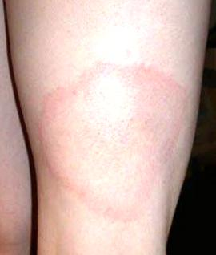
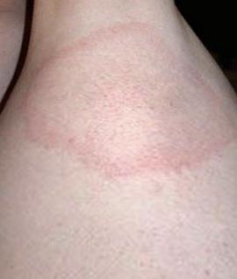
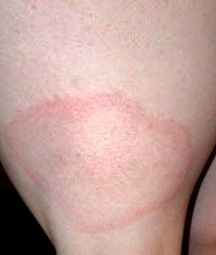
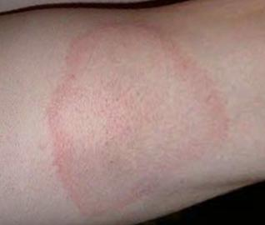
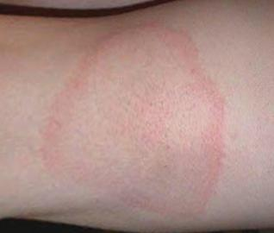
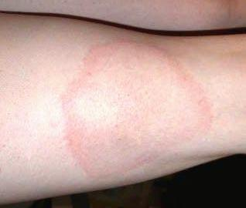
Dermoscopic pre-training for clinical EM lesion image classification Experimental study (Dataset preparation cont.)
Context
Background
Contributions
Conclusion
VALIDATION
10%
TRAIN
TRAIN
TRAIN
TRAIN
TEST
Stratified split of 866 erythema migrans (EM) and 806 Confuser images
Fig. 19: Five-fold cross-validation setup.
Fig. 20: Data augmentation samples.

Slide 22
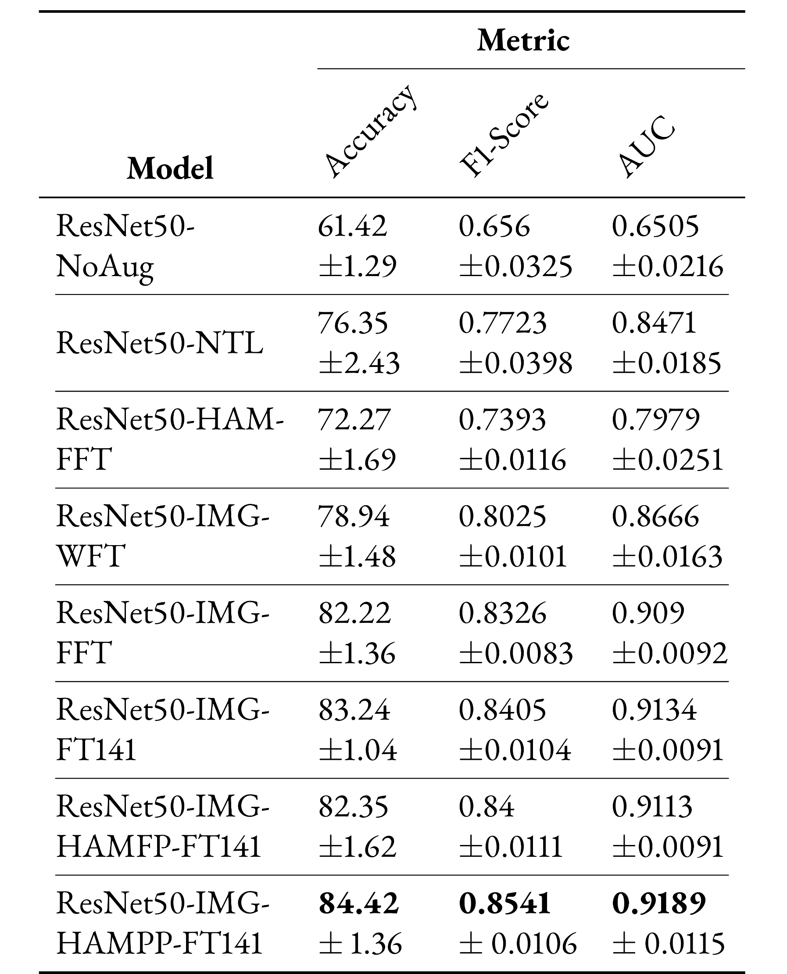
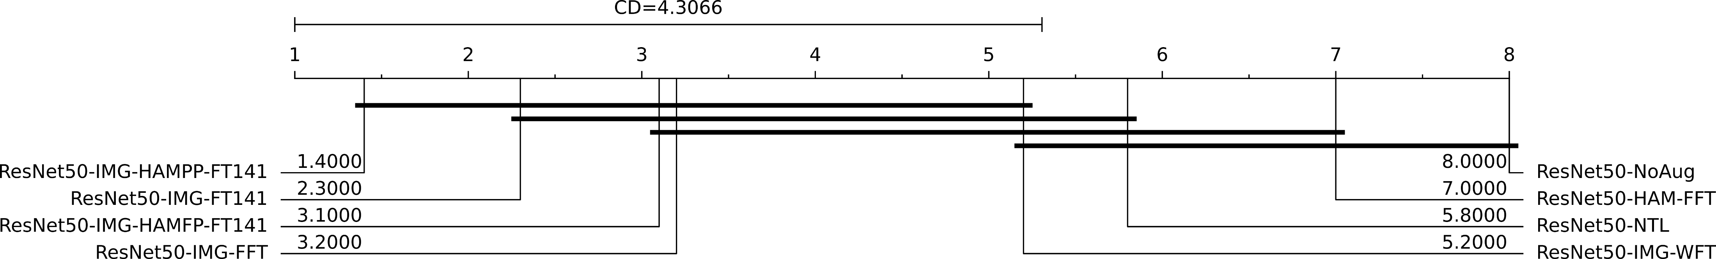
Dermoscopic pre-training for clinical EM lesion image classification Experimental results (Ablation study with ResNet50 architecture)
Context
Background
Contributions
Conclusion
Table 1: Five-fold cross-validation performance metrics of ResNet50 based configurations.
Fig. 21: Accuracy critical difference diagram [8] for ResNet50 based configurations. The models are ordered by best to worst average ranking from left to right. The number beside a model’s name represents the average rank of the model. CD is the critical difference for Nemenyi post-hoc test. Thick horizontal line connects the models that are not statistically significantly different..
Additional metrics

Slide 23
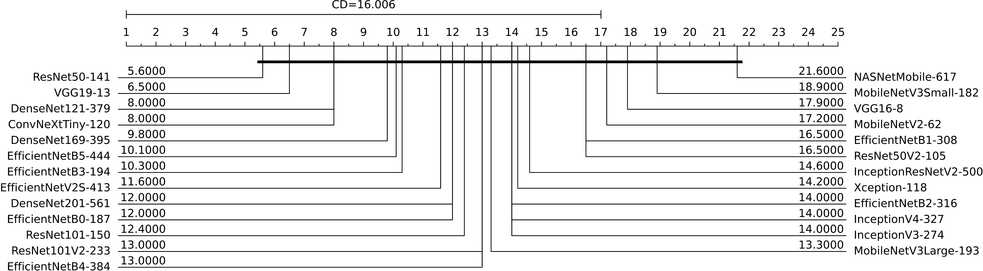
Dermoscopic pre-training for clinical EM lesion image classification Experimental results (Benchmarking CNN architectures for EM classification : CD diagram)
Context
Background
Contributions
Conclusion
Fig. 22: Accuracy critical difference diagram for the best performing configurations of the trained CNN models.
Additional performance metrics
Additional complexity metrics

Slide 24
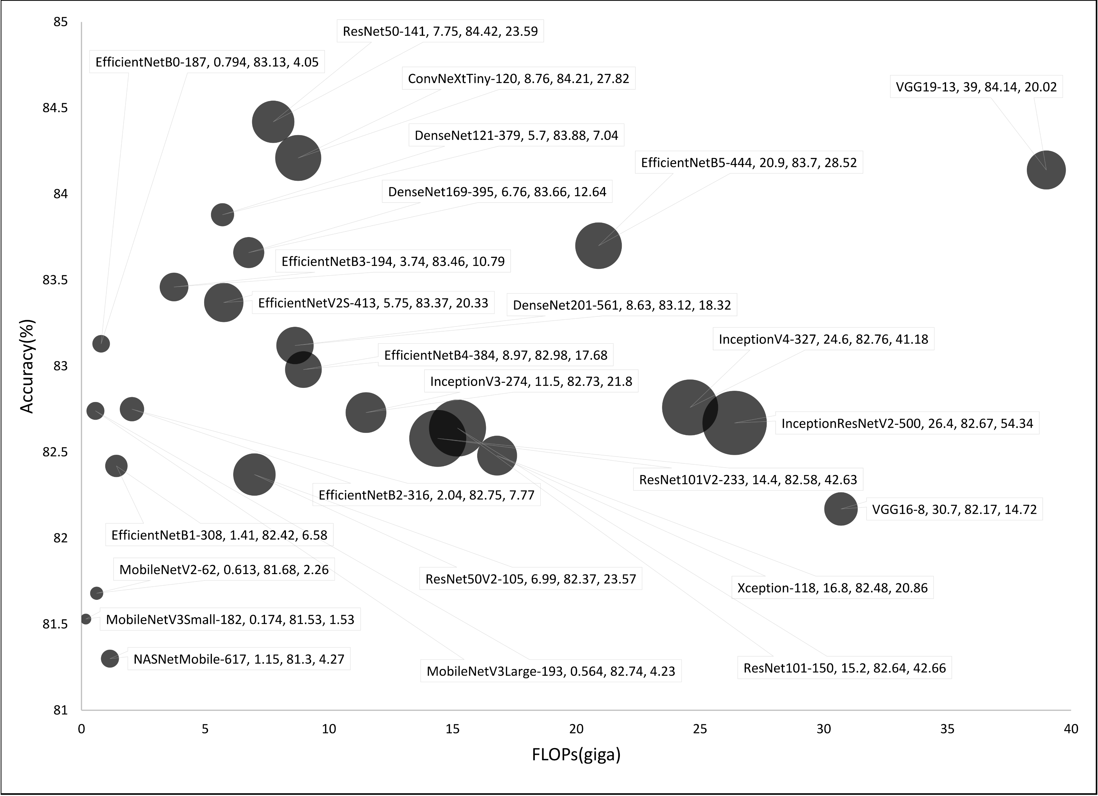
Dermoscopic pre-training for clinical EM lesion image classification Experimental results (Benchmarking CNN architectures for EM classification : accuracy vs complexity bubble chart)
Context
Background
Contributions
Conclusion
Fig. 23: Bubble chart reporting model accuracy vs complexity. The size of each bubble represents the number of model parameters measured in millions unit.

Slide 25
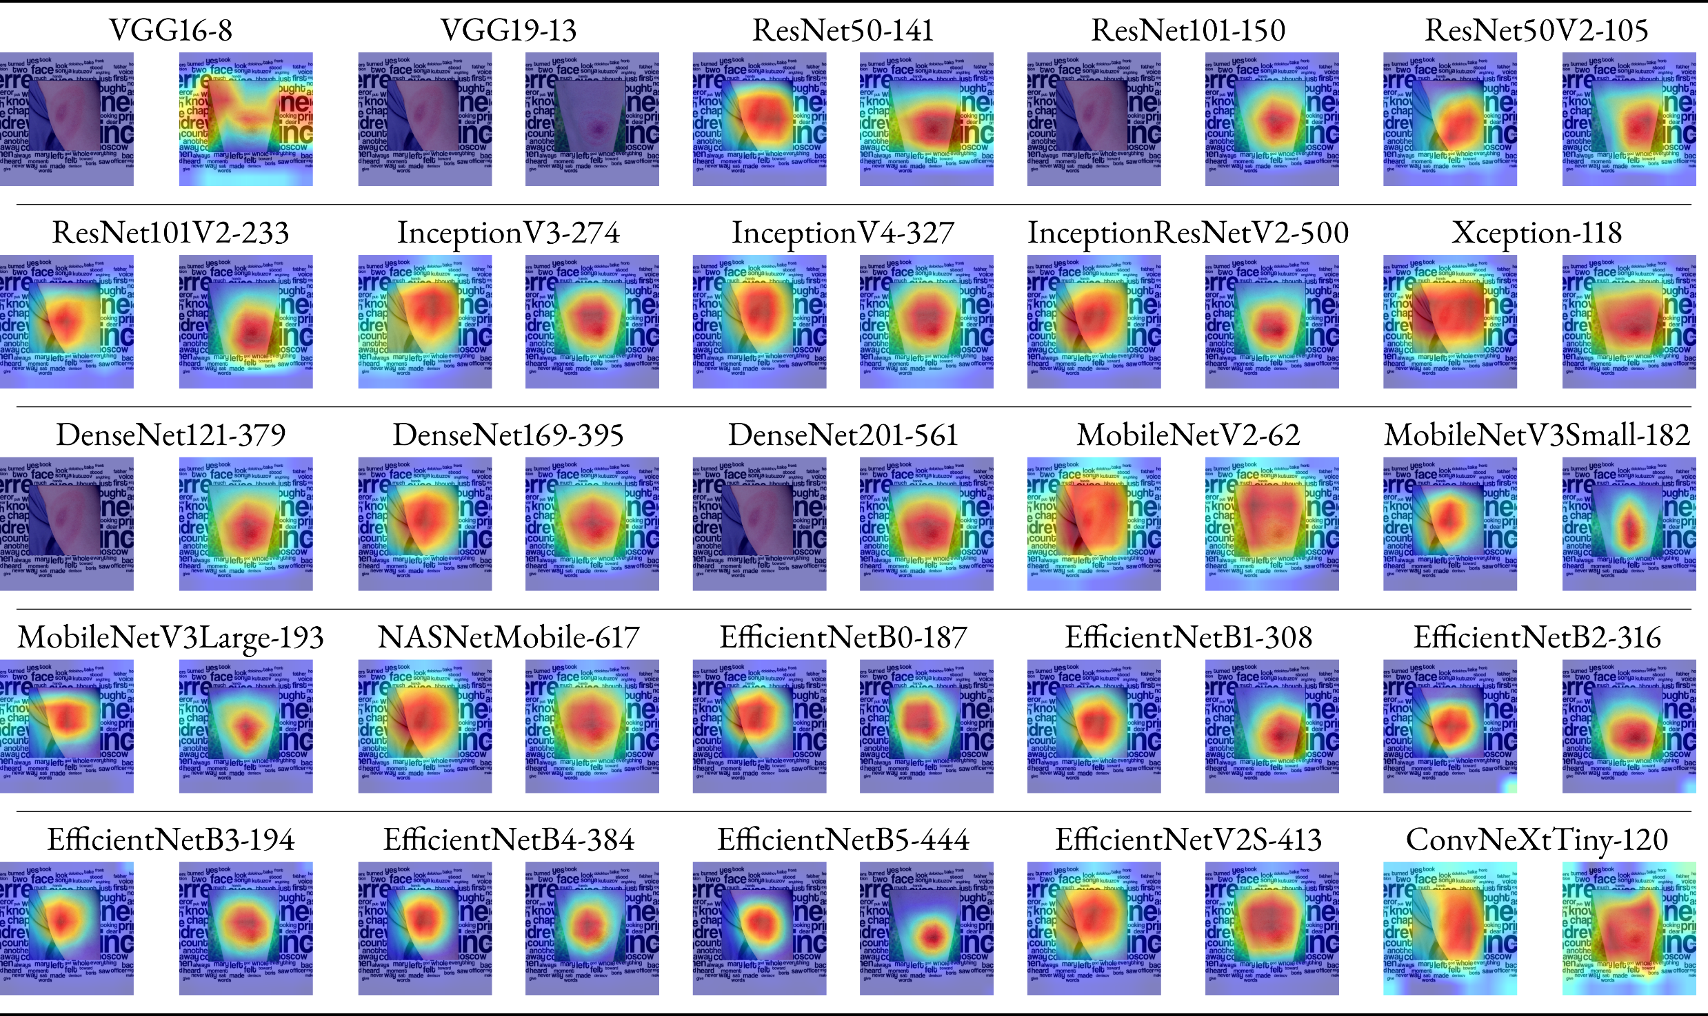
Dermoscopic pre-training for clinical EM lesion image classification Experimental results (Benchmarking CNN architectures for EM classification : heatmap visualization)
Context
Background
Contributions
Conclusion
Fig. 24: Heatmap visualization of the trained models using Grad-CAM.

Slide 26
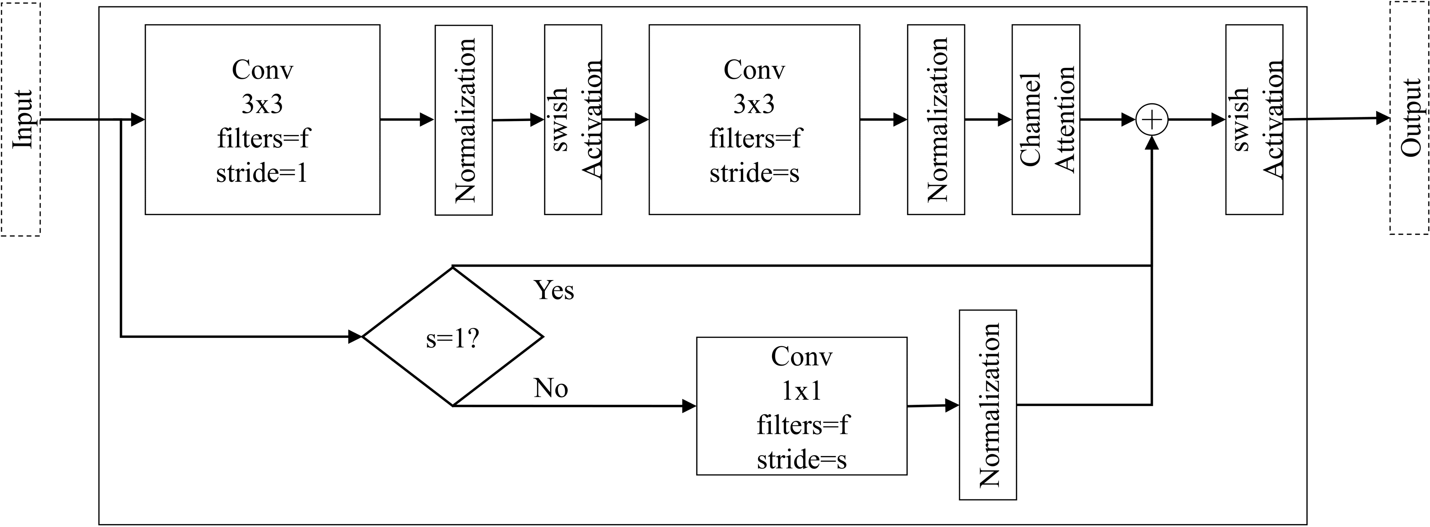
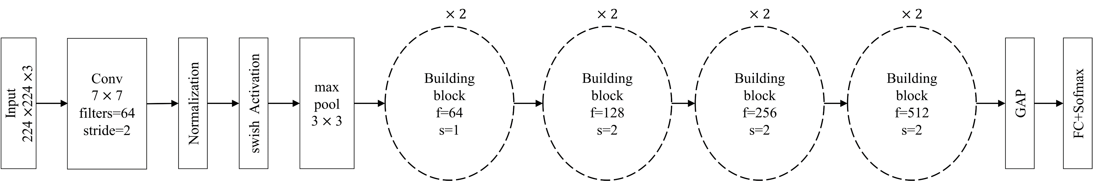
Dermoscopic pre-training for clinical EM lesion image classification Custom CNN architecture for EM classification
Context
Background
Contributions
Conclusion
11.19 M params, 84.68 acc compared to best performing architecture (23.59 M, 84.85 acc).
Tested on updated dataset.
Building block
Fig. 25: Custom CNN architecture for EM classification.

Slide 27
Dermoscopic pre-training for clinical EM lesion image classification Key points
Context
Background
Contributions
Conclusion
Proposed a pre-training strategy to improve transfer learning based clinical EM lesion image classifier's performance with additional pre-training using dermoscopic images.
Benchmarked state-of-the-art CNN architectures on the novel Lyme dataset utilizing our pre-training strategy and results suggest that even lightweight CNNs can be effective for Lyme disease pre-scanner mobile applications.
Publication
S. I. Hossain, J. de Goër de Herve, M. S. Hassan, D. Martineau, E. Petrosyan, V. Corbin, J. Beytout, I. Lebert, J. Durand, I. Carravieri, A. Brun-Jacob, P. Frey-Klett, E. Baux, C. Cazorla, C. Eldin, Y. Hansmann, S. Patrat-Delon, T. Prazuck, A. Raffetin, P. Tattevin, G. Vourc’h, O. Lesens, and E. Mephu Nguifo(2022). Exploring convolutional neural networks with transfer learning for diagnosing Lyme disease from skin lesion images. Computer Methods and Programs in Biomedicine, 215, 106624. https://doi.org/10.1016/j.cmpb.2022.106624

Slide 28

Expert opinion elicitation for dealing with lack of patient data Motivation
Context
Background
Contributions
Conclusion
HAM10000
Novel Lyme Dataset
Custom Pre-training Strategy
Erythema Migrans
Confuser
25 CNN Architectures
Misclassified
images
Initial labeling error!
Proper diagnosis of EM requires both lesion image and patient data [9].

Slide 29
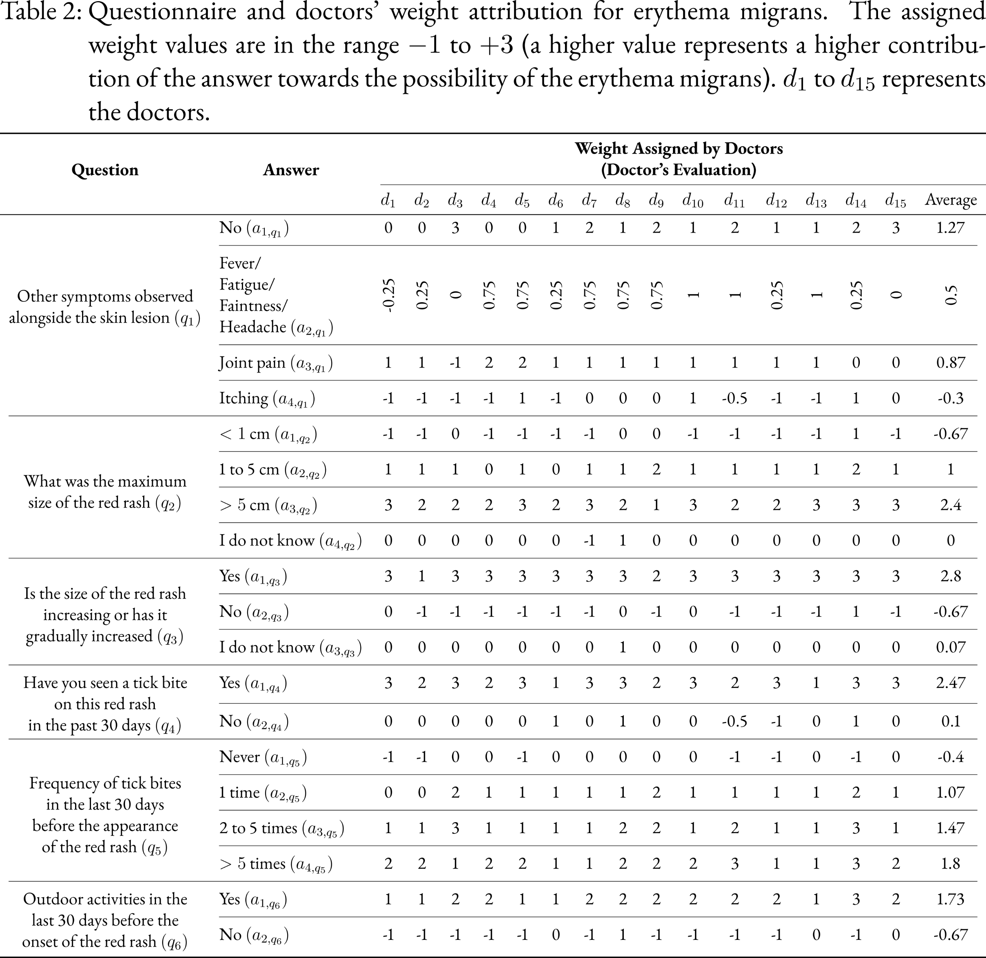
Expert opinion elicitation for dealing with lack of patient data Elicitation process (Questionnaire)
Context
Background
Contributions
Conclusion

Slide 30
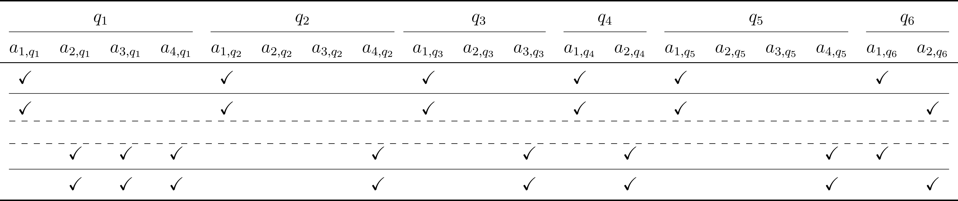
Expert opinion elicitation for dealing with lack of patient data Elicitation process (Questionnaire ) (cont.)
Context
Background
Contributions
Conclusion
1536 possible cases

Slide 31

Expert opinion elicitation for dealing with lack of patient data Elicitation process (Questionnaire and weight attribution from doctors)
Context
Background
Contributions
Conclusion

Slide 32


Expert opinion elicitation for dealing with lack of patient data Elicitation process (notations)
Context
Background
Contributions
Conclusion

Slide 33
Expert opinion elicitation for dealing with lack of patient data Elicitation process (notations)
Context
Background
Contributions
Conclusion

Slide 34









Expert opinion elicitation for dealing with lack of patient data Elicitation process (Approaches)
Context
Background
Contributions
Conclusion
Fig. 26: Proposed approaches for expert opinion elicitation.

Slide 35

Expert opinion elicitation for dealing with lack of patient data Elicitation process (Results)
Context
Background
Contributions
Conclusion
Table 3: Calculated Probabilities for some sample cases.

Slide 36

Expert opinion elicitation for dealing with lack of patient data Elicitation process (Results)
Context
Background
Contributions
Conclusion
Fig. 27: Elicited EM probability plot.

Slide 37




Expert opinion elicitation for dealing with lack of patient data Elicitation process (Explaining model behavior)
Context
Background
Contributions
Conclusion
Decision Tree
Fig. 28: Concept lattice view for low probability score cases [0, 0.1).

Slide 38







Expert opinion elicitation for dealing with lack of patient data Combining probabilities from CNN and elicited model (Illustration)
Context
Background
Contributions
Conclusion
Calibrated
CNN
Confidence as EM Probability, $p_{image}$
Geometric Mean
Lesion
Image
Elicited Model
EM Probability, $p_{data}$
Probability Adjusted Geometric Mean
Patient
Data
$$p_{combined}←\sqrt{p_{image}×p_{data}}$$

Slide 39

Expert opinion elicitation for dealing with lack of patient data Combining probabilities from CNN and elicited model (Algorithm)
Context
Background
Contributions
Conclusion
Collecting data to validate the approach

Slide 40
Expert opinion elicitation for dealing with lack of patient data Key points
Context
Background
Contributions
Conclusion
Proposed a questionnaire based expert opinion elicitation approach that is easier for the experts compared to traditional approach of collecting probability estimates.
Exploited decision tree and formal concept analysis for intuitive explanation of the elicited model behavior.
Proposed an approach for combining the probability score from a deep learning image classifier with the elicited probability score from patient data. (Needs validation with real data)
Publication (to be submitted)
S. I. Hossain, J. de Goër de Herve, D. Abrial, R. Emillion, I. Lebertb, Y. Frendo, D. Martineau, O. Lesens, and E. Mephu Nguifo(2022). Expert Opinion Elicitation for Assisting Deep Learning based Lyme Disease Classifier with Patient Data. https://doi.org/2208.14384

Slide 41

Efficiently dealing with skin lesion hair Hair mask dataset creation
Context
Background
Contributions
Conclusion
Fig. 29: Skin hair mask dataset creation.

Slide 42






Efficiently dealing with skin lesion hair Hair mask dataset creation (cont.)
Context
Background
Contributions
Conclusion
Publication (in revision)
S. I. Hossain, S. S. Roy, J. de Goër de Herve, R. E. Mercer, and E. Mephu Nguifo. “A skin lesion hair mask dataset with fine-grained annotations”. 1, 2023. https://doi.org/10.17632/J5YWPD2P27.1 (minor revision, Data in Brief)
Fig. 30: Skin hair mask dataset samples.

Slide 43
General conclusion and findings
Context
Background
Contributions
Conclusion
A strategy to improve transfer learning based clinical lesion image classifier's performance with additional pre-training using dermoscopic images.
A flexible questionnaire based expert opinion elicitation method to assist skin lesion image classifier with patient data in the absence of training data.
Custom lightweight CNN architecture for EM classification.
A fine-grained skin lesion hair mask annotation dataset for dealing with lesion hair artifacts in an efficient manner.

Slide 44




Application from the thesis
Context
Background
Contributions
Conclusion
Fig. 31: EMScan mobile application.
Funded by the European Regional Development Fund, project DAPPEM –AV0021029, carried out under the Call for Proposal ‘Pack Ambition Research’ from the Auvergne-Rhône-Alpes region, France. This work was also partially funded by Mutualité Sociale Agricole (MSA), France.

Slide 45

Application from the thesis Demonstration
Context
Background
Contributions
Conclusion
Publications
S. I. Hossain, J. de Goër de Herve, Y. Frendo, D. Martineau, I. Lebert, O. Lesens, and E. Mephu Nguifo. “EMScan : une application mobile pour l’assistance au diagnostic des formes précoces de la maladie de Lyme”. Revue des Nouvelles Technologies de l’Information Extraction et Gestion des Connaissances, RNTI-E-39, 2023, pp. 613–620. url: https://editions-rnti.fr/?inprocid=1002869
Y. Frendo, J. de Goër de Herve, S. I. Hossain, D. Martineau, I. Lebert, O. Lesens, and E. Mephu Nguifo. “EMScan: A Mobile Application for Early Lyme Disease Diagnosis”. In: European Conference on Computer Vision ECCV. 2022. Project Demo. url: https://eccv2022.ecva.net/program/demo-list/

Slide 46
Limitations and future directions
Context
Background
Contributions
Conclusion
Reducing the search time for finding the number of layers to unfreeze (pre-training strategy).
Testing the pre-training strategy on multiple clinical lesion image dataset.
Validating the approach of combining probabilities with real case scenarios.

Slide 47


Limitations and future directions Optimizing the custom CNN architecture for EM classification (work plan)
Context
Background
Contributions
Conclusion
Neural Architecture Search
Building block
S. I. Hossain, M. A. Akhand, M. I. Shuvo, N. Siddique, and H. Adeli (2019). Optimization of University Course Scheduling Problem using Particle Swarm Optimization with Selective Search. Expert Systems with Applications, 127, 9–24. https://doi.org/10.1016/j.eswa.2019.02.026
Building block 2

Slide 48
Limitations and future directions Efficiently dealing with skin lesion hair (work plan)
Context
Background
Contributions
Conclusion
Create a generative model for automating the task of hair mask generation.
Create an augmentation pipeline:
Remove skin hair from input lesion image [10].
Generate a hair mask with the trained generative model.
Augment hair on the dermoscopic image using the generated mask [11].
Analyze classification performance for hair removal vs training time augmentation.

Slide 49


Data availability
Context
Background
Contributions
Conclusion
https://dappem.limos.fr

Slide 50
Publications
Context
Background
Contributions
Conclusion
S. I. Hossain, J. de Goër de Herve, M. S. Hassan, D. Martineau, E. Petrosyan, V. Corbin, J. Beytout, I. Lebert, J. Durand, I. Carravieri, A. Brun-Jacob, P. Frey-Klett, E. Baux, C. Cazorla, C. Eldin, Y. Hansmann, S. Patrat-Delon, T. Prazuck, A. Raffetin, P. Tattevin, G. Vourc’h, O. Lesens, and E. Mephu Nguifo(2022). Exploring convolutional neural networks with transfer learning for diagnosing Lyme disease from skin lesion images. Computer Methods and Programs in Biomedicine, 215, 106624. https://doi.org/10.1016/j.cmpb.2022.106624
S. I. Hossain, J. de Goër de Herve, D. Abrial, R. Emillion, I. Lebertb, Y. Frendo, D. Martineau, O. Lesens, and E. Mephu Nguifo(2022). Expert Opinion Elicitation for Assisting Deep Learning based Lyme Disease Classifier with Patient Data. https://doi.org/2208.14384 (to be submitted)
S. I. Hossain, S. S. Roy, J. de Goër de Herve, R. E. Mercer, and E. Mephu Nguifo. “A skin lesion hair mask dataset with fine-grained annotations”. 1, 2023. https://doi.org/10.17632/J5YWPD2P27.1 (minor revision, Data in Brief)
S. I. Hossain, J. de Goër de Herve, Y. Frendo, D. Martineau, I. Lebert, O. Lesens, and E. Mephu Nguifo. “EMScan : une application mobile pour l’assistance au diagnostic des formes précoces de la maladie de Lyme”. Revue des Nouvelles Technologies de l’Information Extraction et Gestion des Connaissances, RNTI-E-39, 2023, pp. 613–620. url: https://editions-rnti.fr/?inprocid=1002869
Y. Frendo, J. de Goër de Herve, S. I. Hossain, D. Martineau, I. Lebert, O. Lesens, and E. Mephu Nguifo. “EMScan: A Mobile Application for Early Lyme Disease Diagnosis”. In: European Conference on Computer Vision ECCV. 2022. Project Demo. url: https://eccv2022.ecva.net/program/demo-list/
S. I. Hossain. “Early Diagnosis of Lyme Disease by Recognizing Erythema Migrans SkinLesion from Images Utilizing Deep Learning Techniques”. In: IJCAI International Joint Conference on Artificial Intelligence. International Joint Conferences on Artificial Intelligence Organization, Vienna, 2022, pp. 5855–5856. isbn: 9781956792003. https://doi.org/10 .24963/ijcai.2022/830

Slide 51

References I
[1] | T.J. Brinker et. al., Deep learning outperformed 136 of 157 dermatologists in a head-to-head dermoscopic melanoma image classification task, Eur. J. Cancer. 113 (2019) 47–54. https://doi.org/10.1016/j.ejca.2019.04.001.
[2] | R.C. Maron et. al., Systematic outperformance of 112 dermatologists in multiclass skin cancer image classification by convolutional neural networks, Eur. J. Cancer. 119 (2019) 57–65. https://doi.org/10.1016/j.ejca.2019.06.013.
[3] | P. Tschandl et. al., The HAM10000 dataset, a large collection of multi-source dermatoscopic images of common pigmented skin lesions, Sci. Data. 5 (2018) 180161. https://doi.org/10.1038/sdata.2018.161.
[4] | Q. Chen, M. Li, C. Chen, P. Zhou, X. Lv, C. Chen, MDFNet: application of multimodal fusion method based on skin image and clinical data to skin cancer classification, J. Cancer Res. Clin. Oncol. (2022). https://doi.org/10.1007/s00432-022-04180-1.
[5] | [1] A.G.C. Pacheco, R.A. Krohling, An Attention-Based Mechanism to Combine Images and Metadata in Deep Learning Models Applied to Skin Cancer Classification, IEEE J. Biomed. Heal. Informatics. 25 (2021) 3554–3563. https://doi.org/10.1109/JBHI.2021.3062002.

Slide 52
References II
[6] | H.H. Mao, A Survey on Self-supervised Pre-training for Sequential Transfer Learning in Neural Networks, (2020). http://arxiv.org/abs/2007.00800.
[7] | S. Azizi, B. Mustafa, F. Ryan, Z. Beaver, J. Freyberg, J. Deaton, A. Loh, A. Karthikesalingam, S. Kornblith, T. Chen, V. Natarajan, M. Norouzi, Big Self-Supervised Models Advance Medical Image Classification, in: Proc. IEEE Int. Conf. Comput. Vis., IEEE, 2021: pp. 3458–3468. https://doi.org/10.1109/ICCV48922.2021.00346.
[8] | J. Demšar, Statistical comparisons of classifiers over multiple data sets, J Mach Learn Res 7 (2006) 1-30. https://www.jmlr.org/papers/volume7/demsar06a/demsar06a.pdf.
[9] | P.M. Burlina, N.J. Joshi, P.A. Mathew, W. Paul, A.W. Rebman, J.N. Aucott, AI-based detection of erythema migrans and disambiguation against other skin lesions, Comput. Biol. Med. 125 (2020) 103977. https://doi.org/10.1016/j.compbiomed.2020.103977.
[10] | Li, W., Joseph Raj, A. N., Tjahjadi, T., & Zhuang, Z. (2021). Digital hair removal by deep learning for skin lesion segmentation. Pattern Recognition, 117, 107994. https://doi.org/10.1016/J.PATCOG.2021.107994
[11] | Attia, M., Hossny, M., Zhou, H., Nahavandi, S., Asadi, H., & Yazdabadi, A. (2020). Realistic hair simulator for skin lesion images: A novel benchemarking tool. Artificial Intelligence in Medicine, 108, 101933. https://doi.org/10.1016/j.artmed.2020.101933

Slide 53

Thank you for your attention

Slide 54

Dermoscopic pre-training for clinical EM lesion image classification Experimental results (Ablation study with ResNet50 architecture) : All metrics
Appendix
Table A1: Five-fold cross-validation performance metrics of ResNet50 based configurations.

Slide 55


Dermoscopic pre-training for clinical EM lesion image classification Experimental results (trained CNN models) : All metrics
Appendix
Table A2: Five-fold cross-validation performance metrics of trained CNN models.

Slide 56

Dermoscopic pre-training for clinical EM lesion image classification Model complexity of CNN architectures
Appendix
Table A3: Complexity metrics of trained CNN models.

Slide 57

Decision tree based model behavior explanation
Appendix
Fig. A1: Pruned decision tree explaining elicited EM probability model behavior.

Slide 58

Formal concept lattice
Appendix
Fig. A2: Example of a formal context in tabular form and corresponding concept lattice.

Slide 59


Convolution operations
Appendix
Fig. A3: Dilated convolution.
Fig. A4: Depthwise separable convolution.

Slide 60


CNN architectures
Appendix
Fig. A5: ResNet building block.
Fig. A5: EfficientNet building block.

